Slide 1


Slide 2
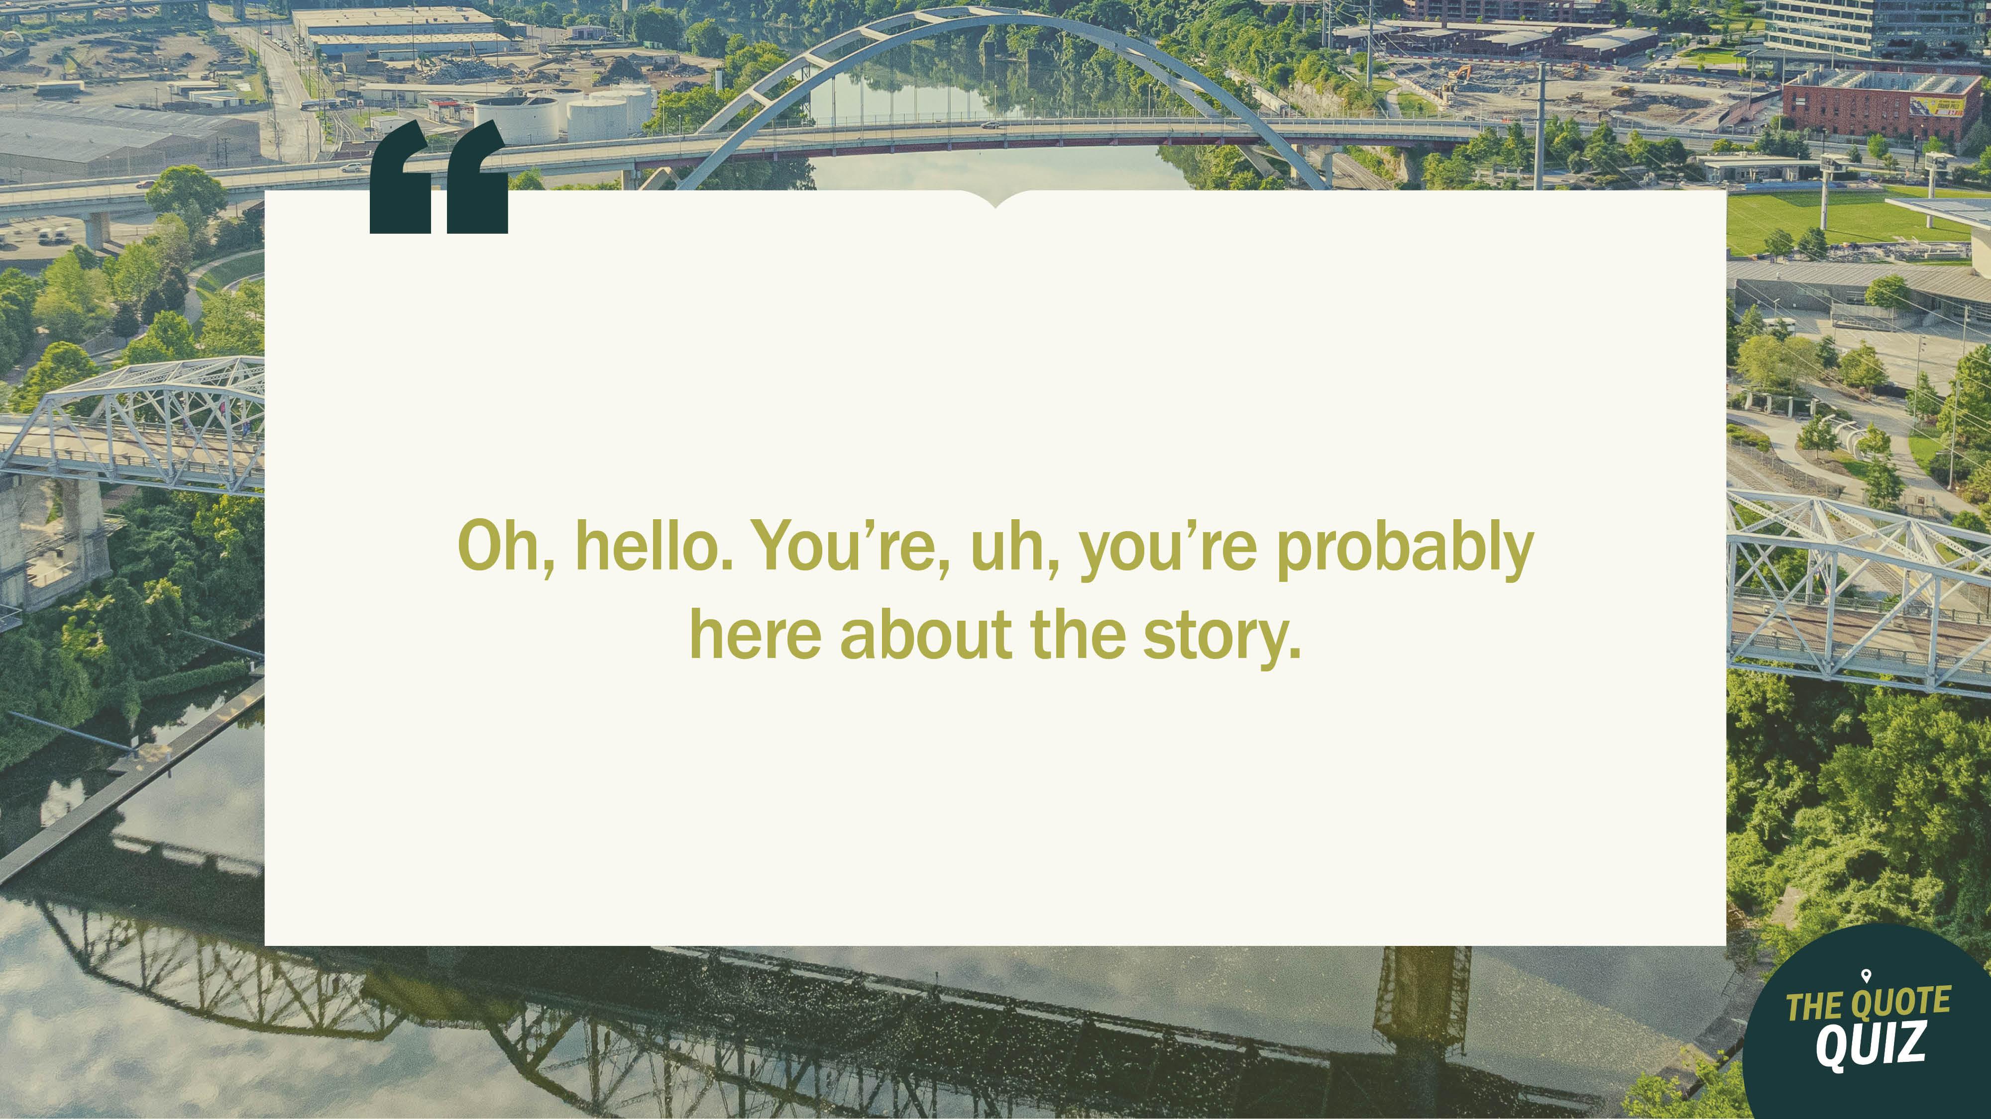
Notes:
Big Idea

Slide 3

Notes:
Tension/Big Idea

Slide 4
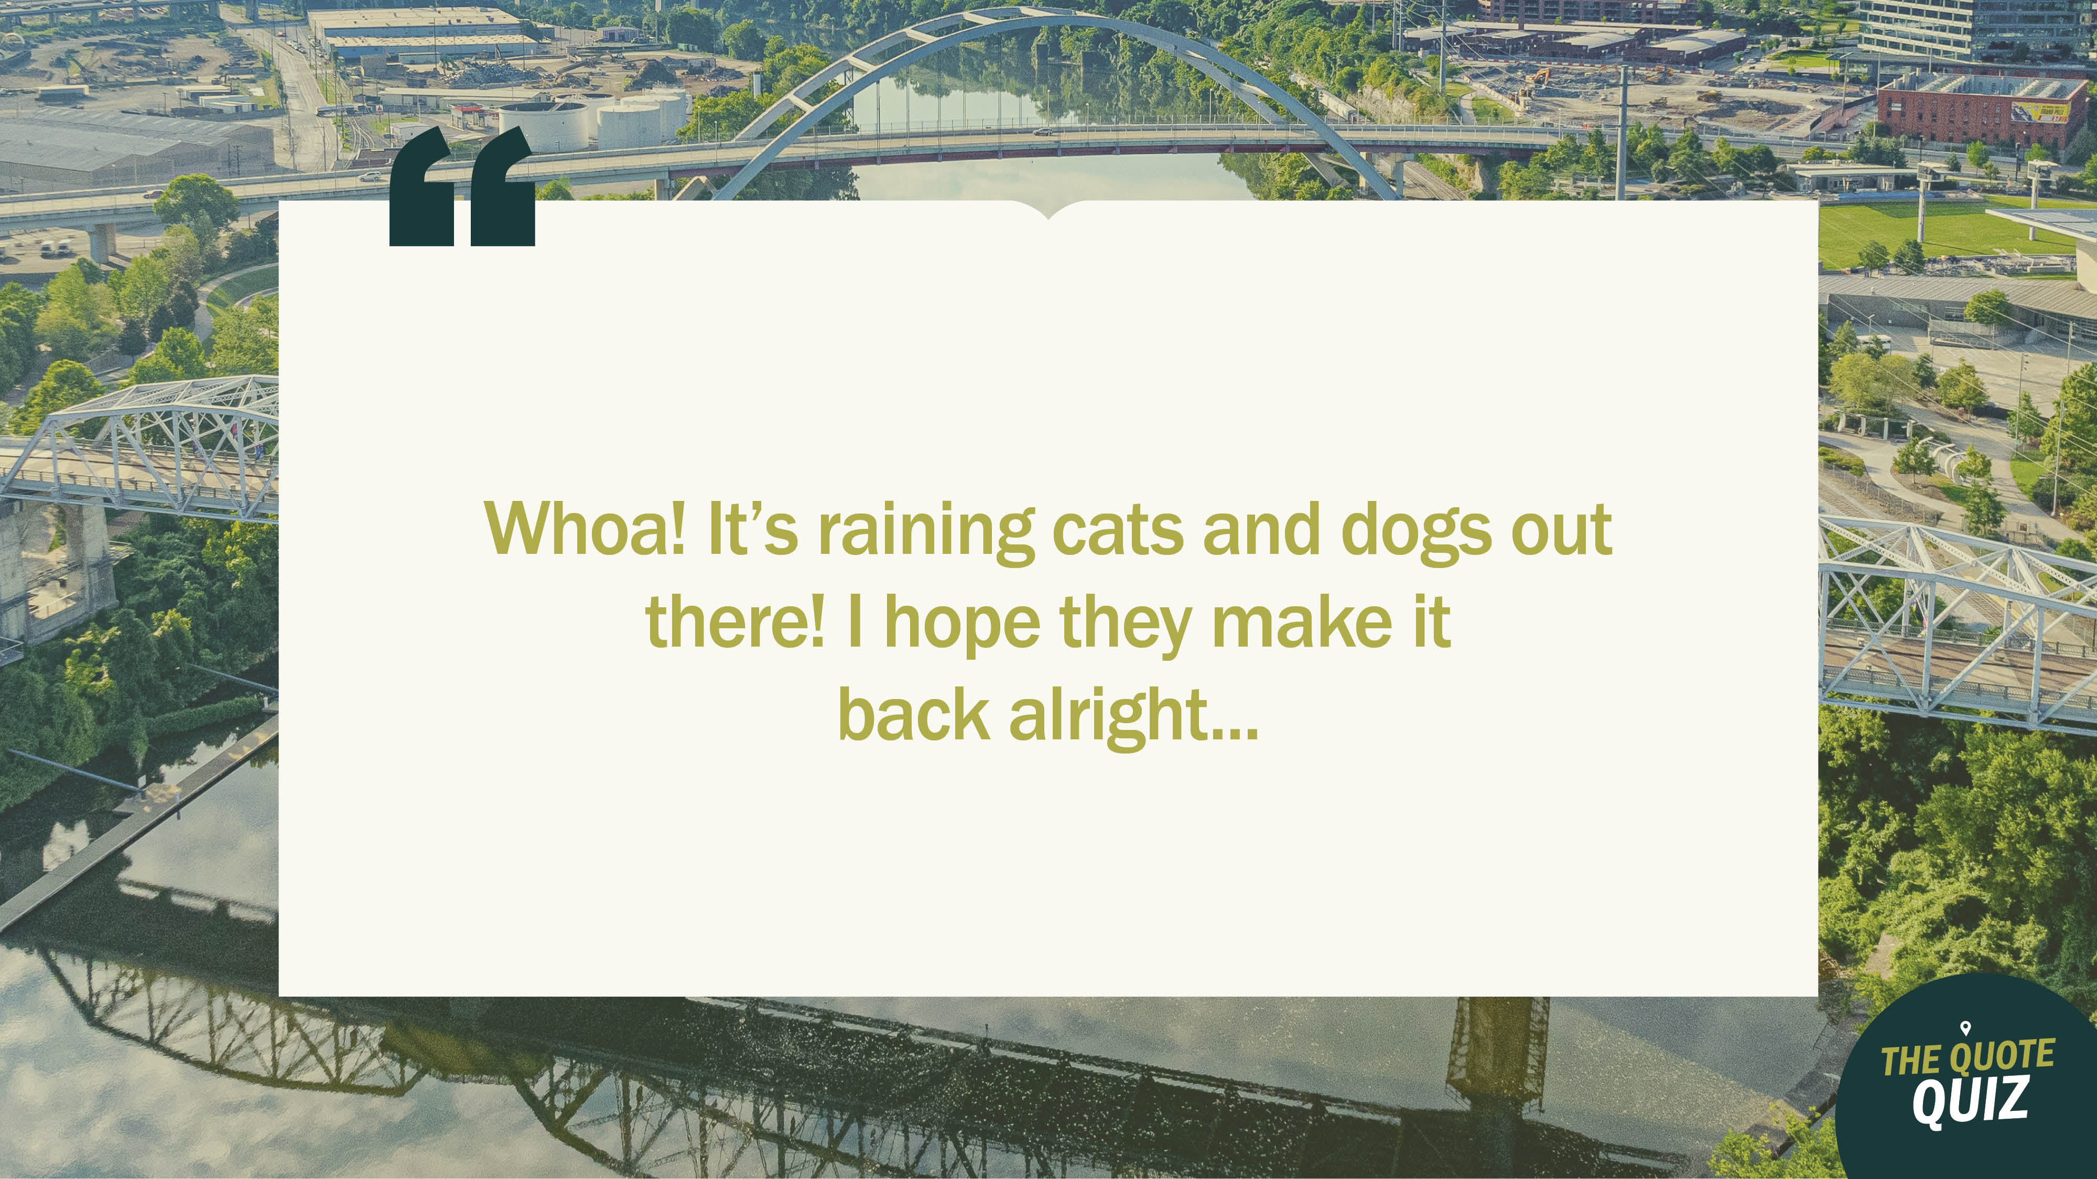
Notes:
Memory Verse

Slide 5


Slide 6


Slide 7
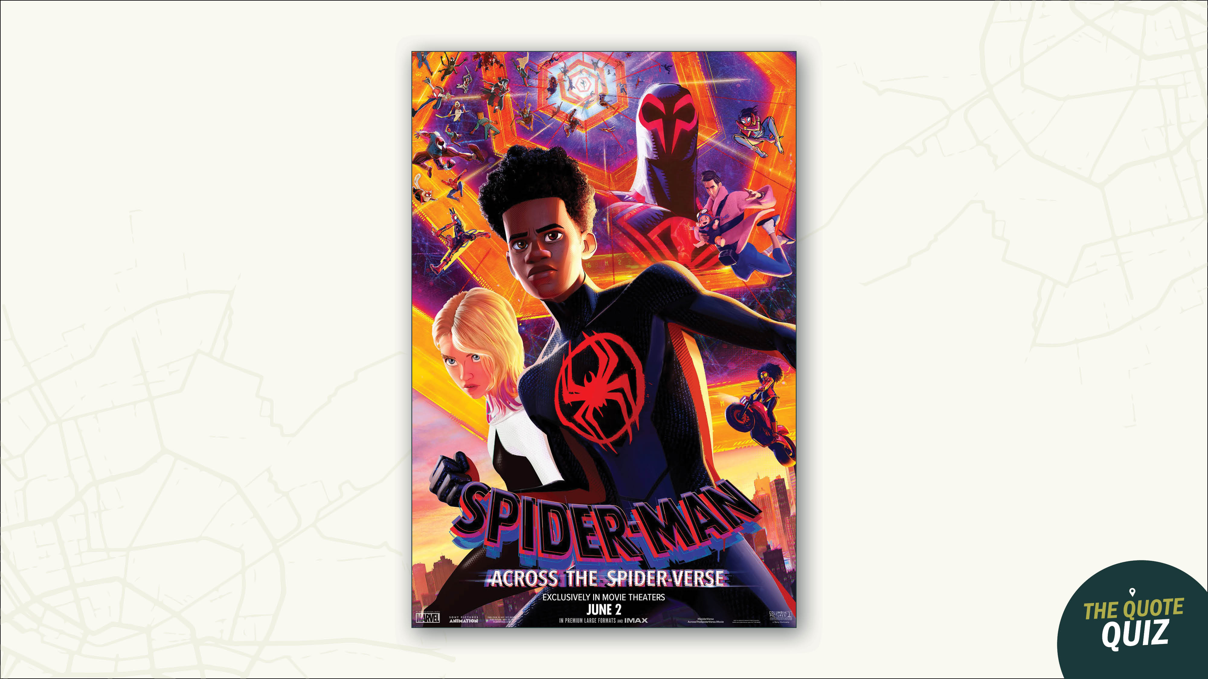

Slide 8
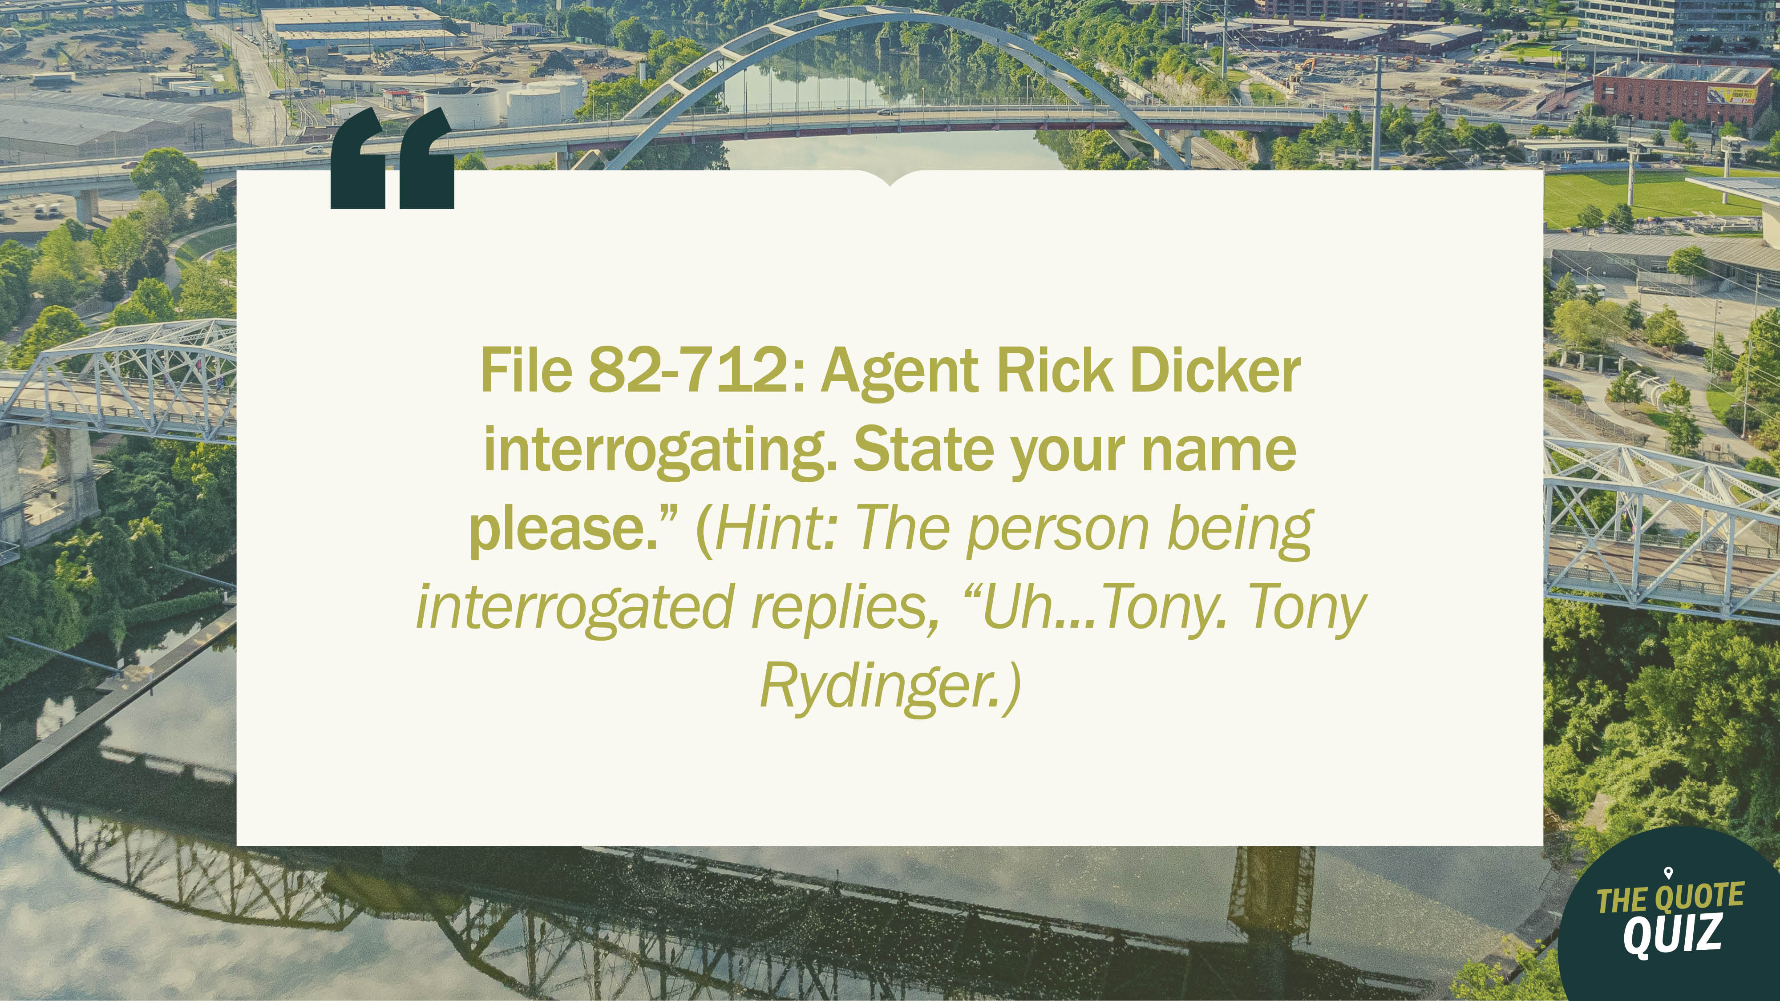

Slide 9
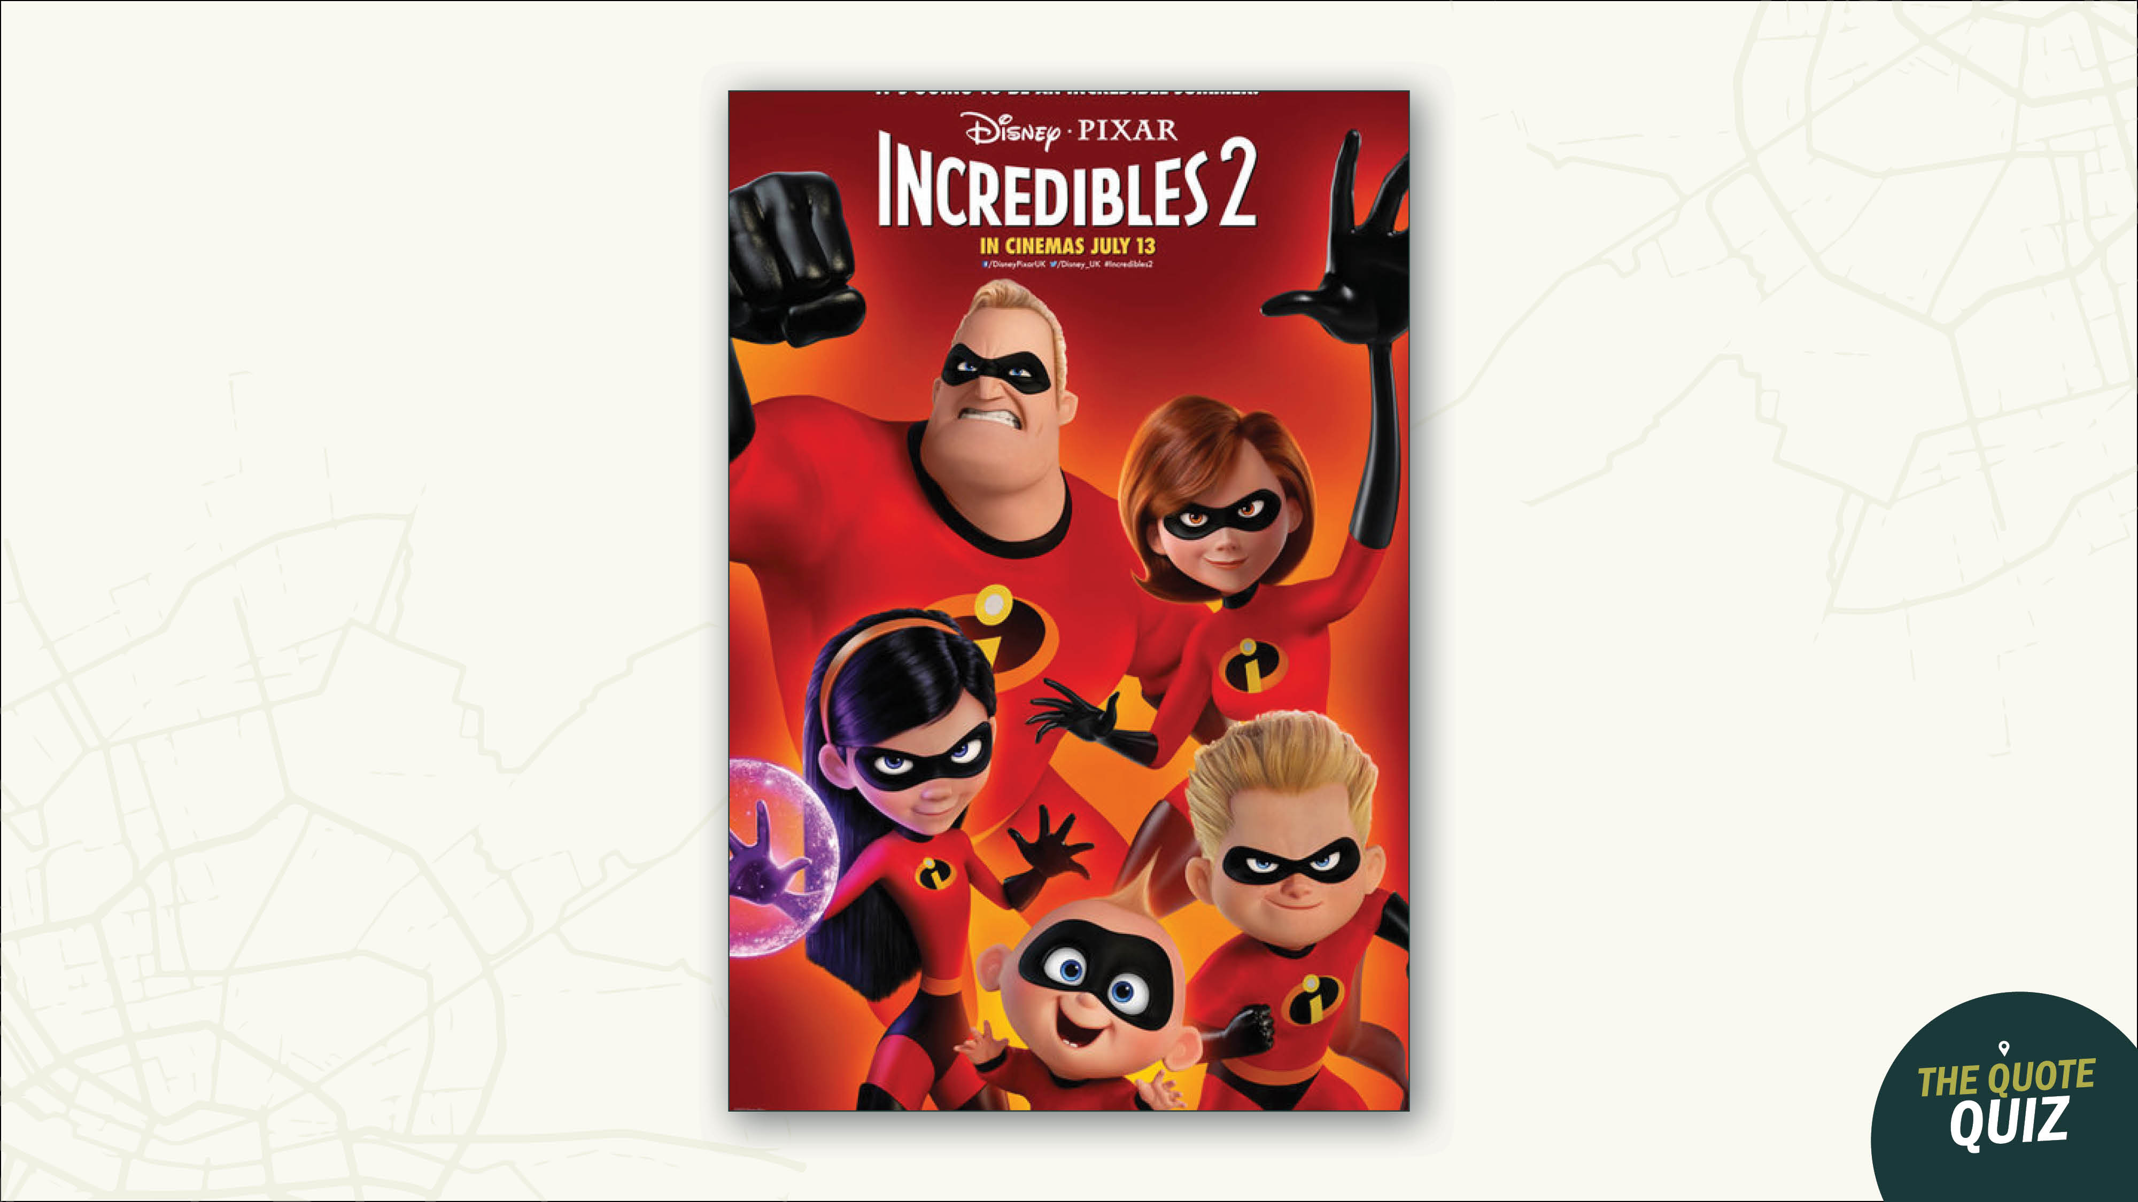

Slide 10
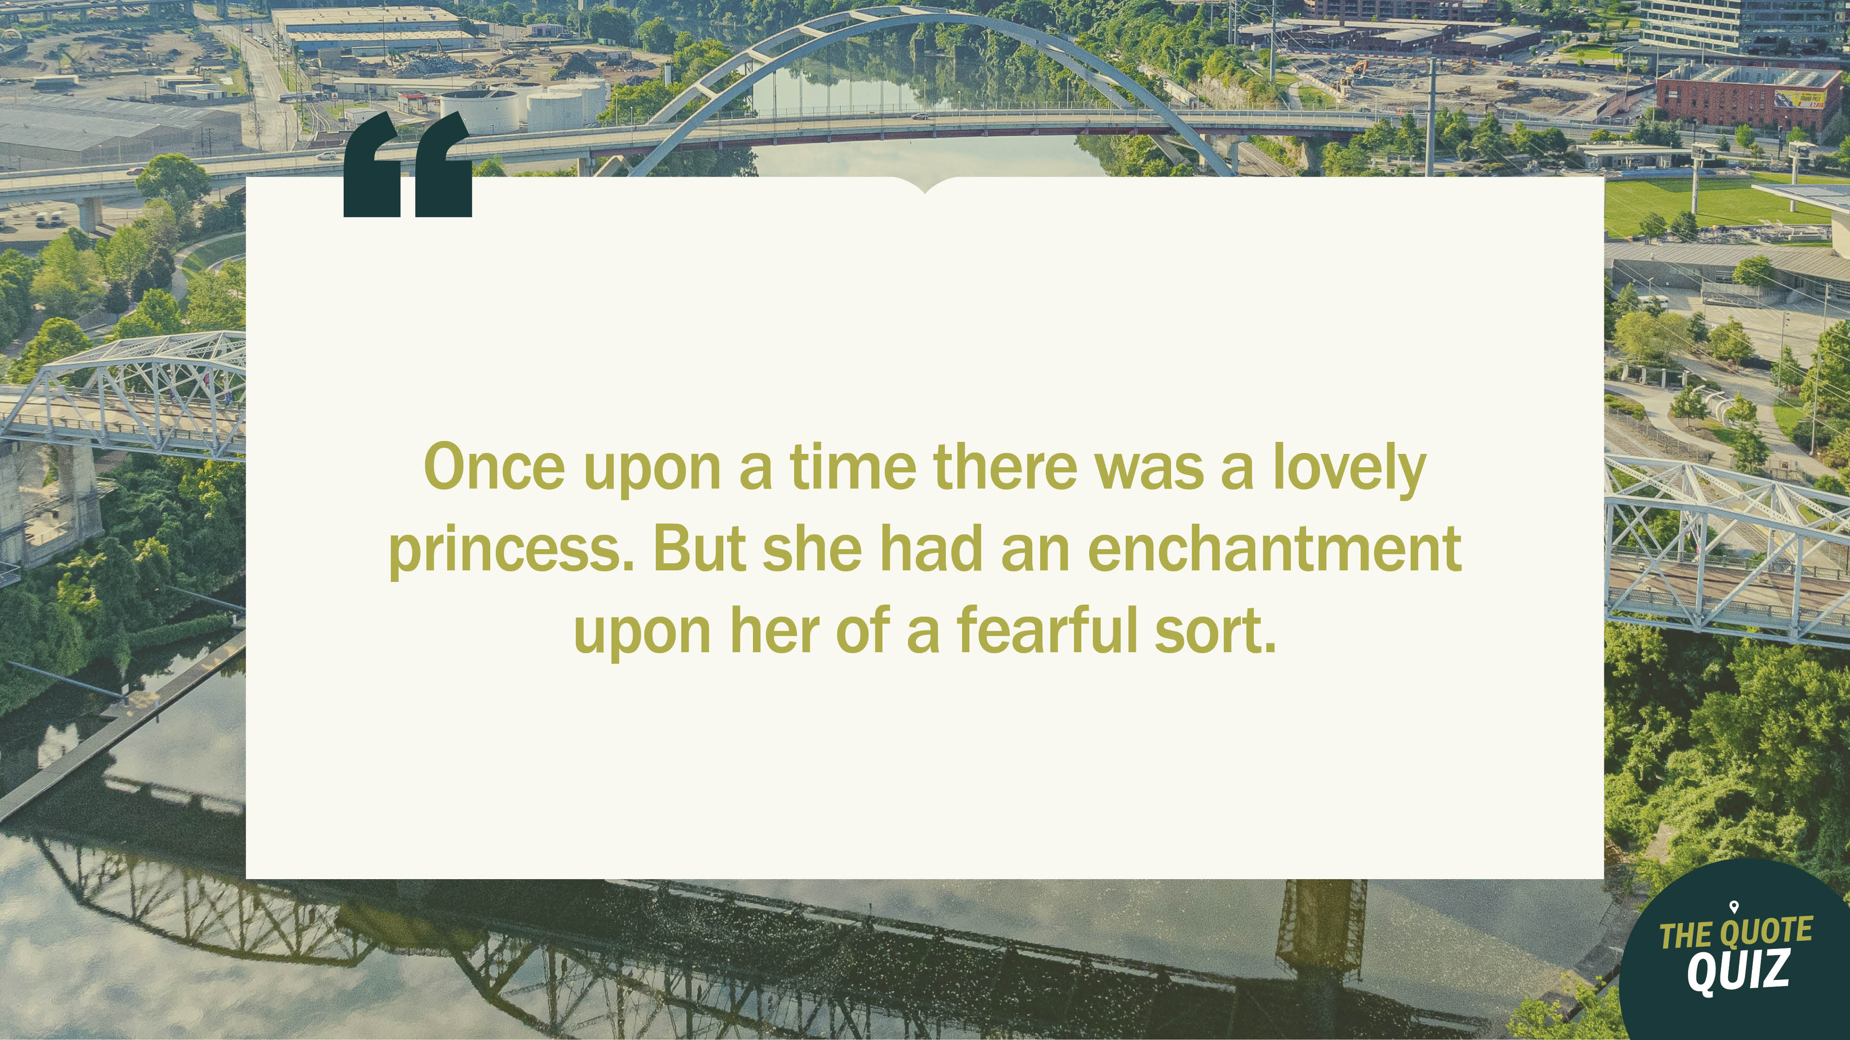

Slide 11
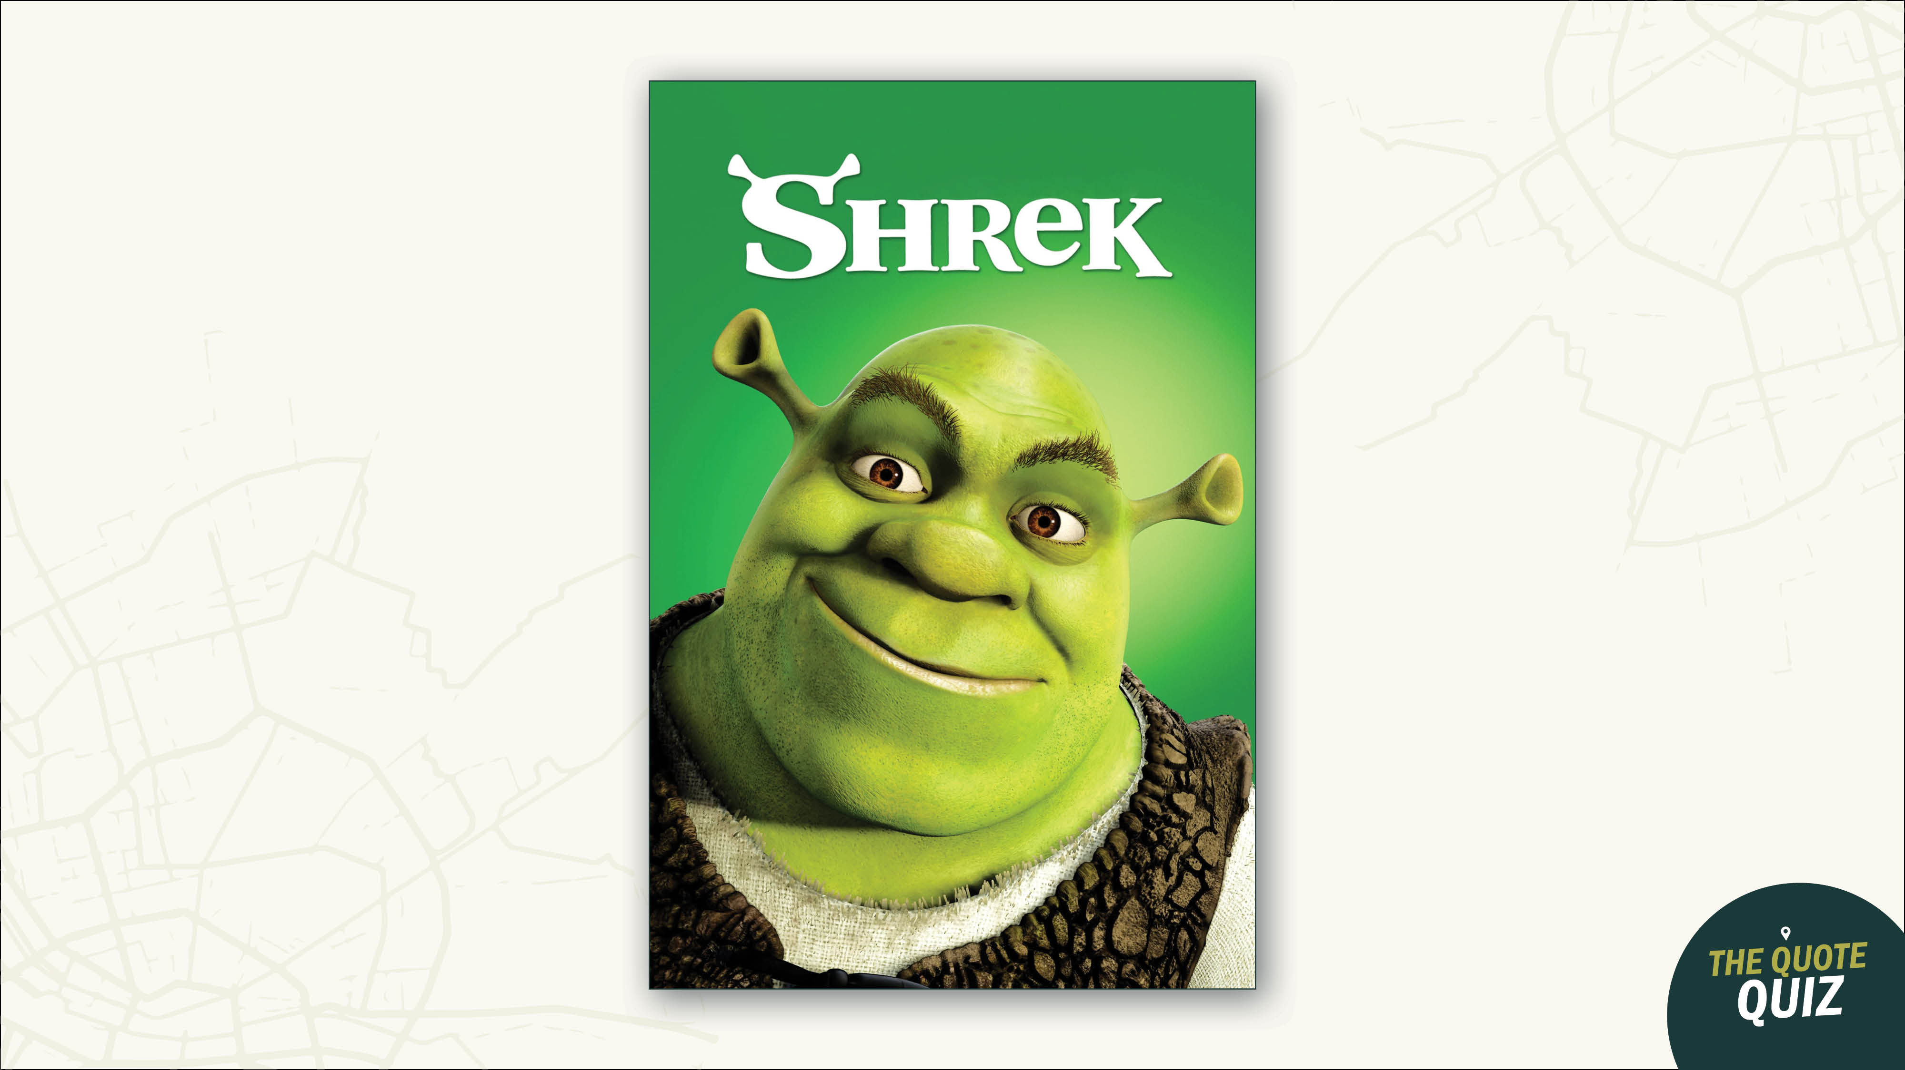

Slide 12
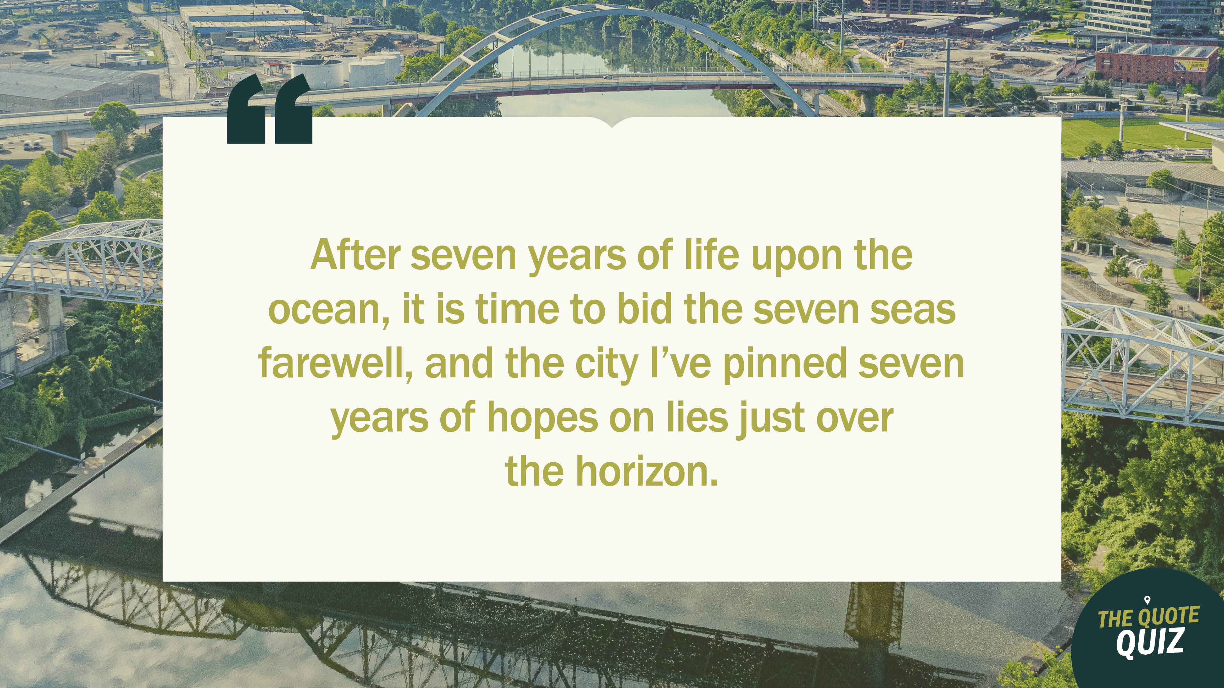

Slide 13


Slide 14


Slide 15
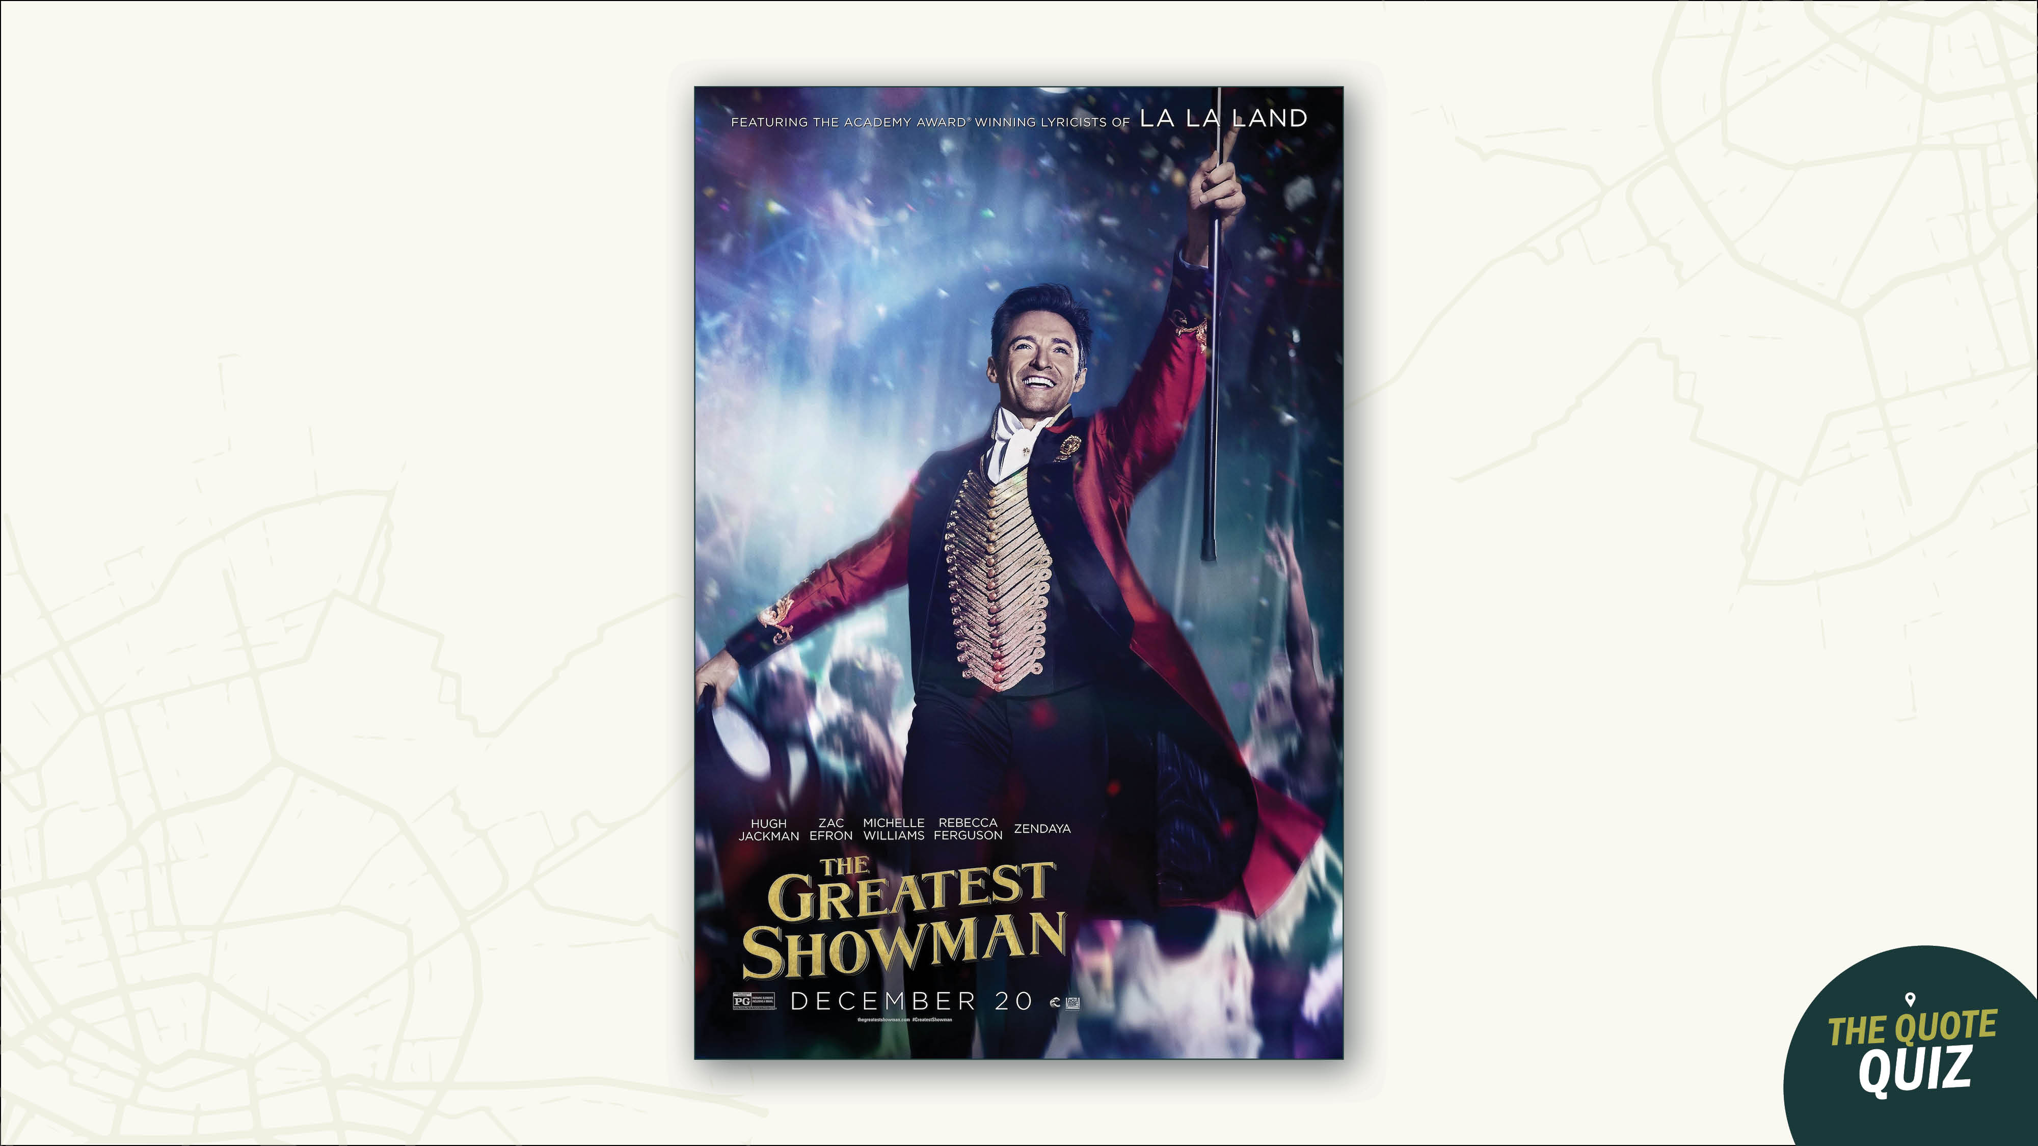

Slide 16
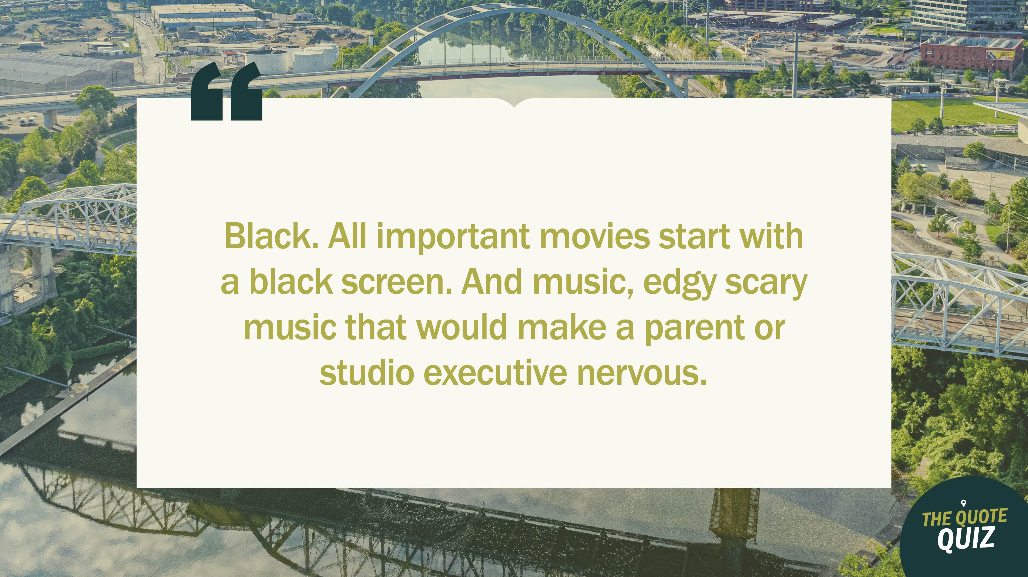

Slide 17
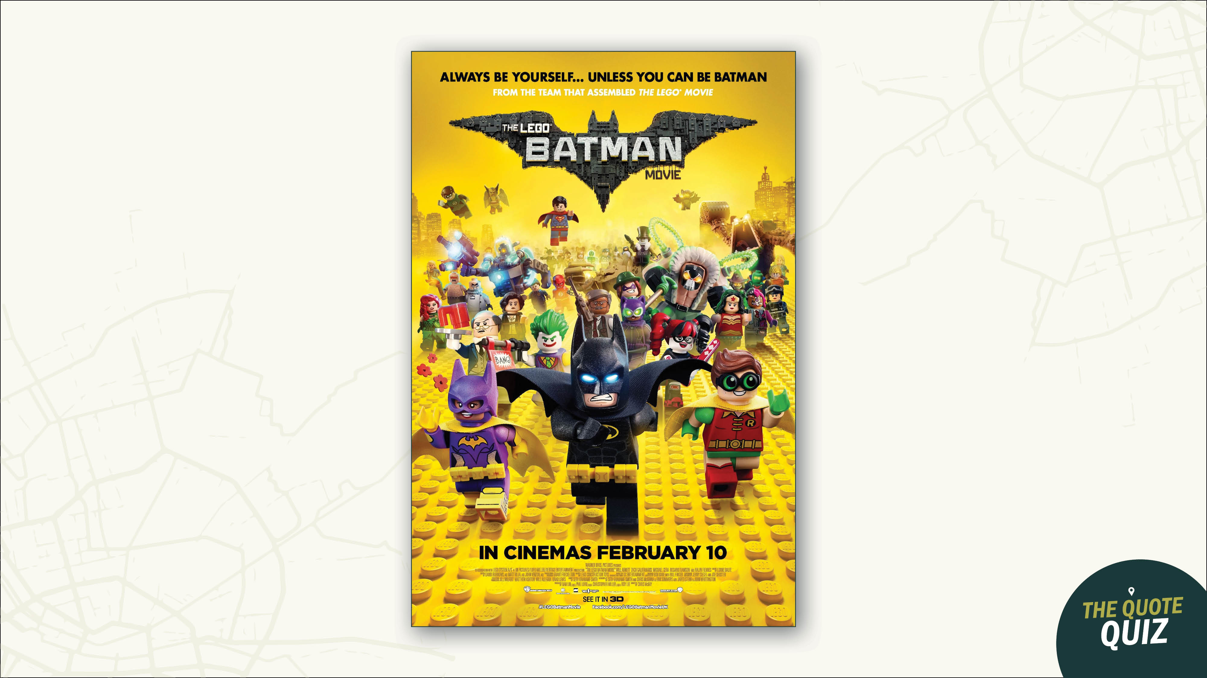

Slide 18


Slide 19


Slide 20


Slide 21


Slide 22
